Slide 1
C++ Introduction

Slide 2
C++ Basics
History
Programming languages
Hello World!
  Libraries
  The main method
  Output

Slide 3
Brief History of C++
Derived from C
  Adds classes and other features
  Including the increment operator, ++
Developed by Bjarne Stroustrup at Bell Labs in 1979
Standardized by ANSI-ISO in 1998

Slide 4
Programming Languages
C++ is a high level programming language
  It can be compiled into machine code
  And executed on a computer
Programming languages are formal and lack the richness of human languages
  If a program is nearly syntactically correct (but not correct) then it will not compile
  The compiler will not "figure it out"

Slide 5
So
Though C++ programs are written in an English like language they are very formal
  They must be written using correct syntax
  They must be precise and unambiguous
A program is a sequence of instructions that must be followed step by step
  Each instruction must be correctly specified for the program to function as desired

Slide 6
Processing a C++ Project
run-time errors
correct errors
Source File (.cpp)
write in a text editor
Debugged Executable
compile
test
Object File (binary)
syntax errors
link errors
linker links files
Other Object Files
Executable File (binary)

Slide 7
HELLO WORLD! 1st way

Slide 8
1 // Fig. 1.2: fig01_02.cpp
2 // A first program in C++
Comments
Written between /* and */ or following a //.
Improve program readability and do not cause the computer to perform any action.
3 #include <iostream>
4
5 int main()
6 {
preprocessor directive
Message to the C++ preprocessor.
Lines beginning with # are preprocessor directives.
#include <iostream> tells the preprocessor to include the contents of the file <iostream>, which includes input/output operations (such as printing to the screen).
7 std::cout << "Welcome to C++!\n";
8
9 return 0; // indicate that program ended successfully
10 }
C++ programs contain one or more functions, one of which must be main
Parenthesis are used to indicate a function
int means that main "returns" an integer value. More in the next class.
Welcome to C++!
Prints the string of characters contained between the quotation marks.
The entire line, including std::cout, the << operator, the string "Welcome to C++!\n" and the semicolon (;), is called a statement.
All statements must end with a semicolon.
return is a way to exit a function from a function.
return 0, in this case, means that the program terminated normally.
A left brace { begins the body of every function and a right brace } ends it.

Slide 9
1.19 A Simple Program:
Printing a Line of Text
std::cout
  Standard output stream object
  “Connected” to the screen
  std:: specifies the "namespace" which cout belongs to
    std:: can be removed through the use of using statements

Slide 10
1.19 A Simple Program:
Printing a Line of Text
<<
  Stream insertion operator
  Value to the right of the operator (right operand) inserted into output stream (which is connected to the screen)
  std::cout << “Welcome to C++!\n”;
\
  Escape character
  Indicates that a “special” character is to be output

Slide 11
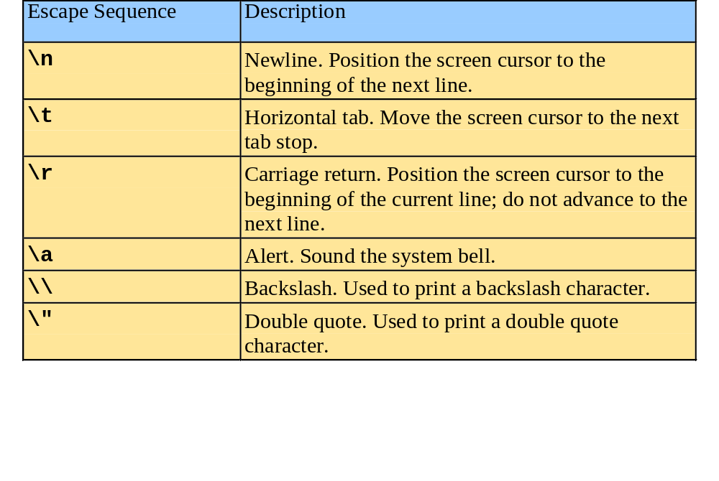
1.19 A Simple Program:
Printing a Line of Text
There are multiple ways to print text
  Following are more examples

Slide 12
1.20 Another Simple Program:
Adding Two Integers
>> (stream extraction operator)
  When used with std::cin, waits for the user to input a value and stores the value in the variable to the right of the operator
  The user types a value, then presses the Enter (Return) key to send the data to the computer
  Example:
      int myVariable;
      std::cin >> myVariable;
    Waits for user input, then stores input in myVariable

Slide 13
1.20 Another Simple Program:
Adding Two Integers
= (assignment operator)
  Assigns value to a variable
  Binary operator (has two operands)
  Example:
      sum = variable1 + variable2;

Slide 14
Hello World 2nd way
#include <iostream>
using namespace std;
int main(){
  cout << "Hello World!";
  return 0;
}

Slide 15
Libraries
A program may need to use functions included in other libraries
  The built in libraries of C++, or
  Libraries developed by users
To use library functions a program must import the library

Slide 16
Including Files
The #include directive is used to insert a library file into a program
  The library file contains declarations (names) of all of the functions in the library
There are two general forms of the #include directive
  #include <library>
    The file is part of the C++ language
  #include "library"
    The file location should be specified by the programmer
#include <iostream>
using namespace std;
int main(){
  cout << "Hello World!";
  return 0;
}

Slide 17
Preprocesser Directives
The # indicates a command for the C++ preprocessor
  Known as a preprocessor directive
  Such commands do not end in a semi-colon
The C++ preprocessor copies the contents of the included file into the program
  Replacing the line containing the directive
  Such files contain function headers

Slide 18
User Libraries
Unlike standard libraries the preprocessor needs the location of user libraries
  Such libraries are given in quotes ("")
  The location of the file must be specified by the programmer
  Locations are given relative to the directory containing the source file
  File extensions should be given
    e.g. #include "myfile.h"

Slide 19
Namespaces (briefly)
Two different programmers might use the same name for some function or class
  Which would result in ambiguity
  Namespaces deal with this issue
A namespace collects name definitions
  And ensures that duplicate names do not exist
  The std namespace contains names defined in many standard C++ libraries
#include <iostream>
using namespace std;
int main(){
  cout << "Hello World!";
  return 0;
}

Slide 20
Main Function
A C++ program is made up of a number of functions
  A function is self contained part of a program
  Every C++ application has a main function
  The main function is called when the executable file is run
The main function is made up of two parts
  Its header: int main()
  Its body: the code in {}s
#include <iostream>
using namespace std;
int main(){
  cout << "Hello World!";
  return 0;
}

Slide 21
More About {}s
The main function's body starts with an opening {
  And ends with a closing }
These curly brackets are used to indicate a body of code
  Belonging to a function, or
  Loop, or
  Decision

Slide 22
Screen Output
cout is a function in the iostream library
  It outputs to the screen
  The << operator is often called the insertion operator
"Hello World!" is a string
  Words contained in double quotes ("") are treated as arbitrary text by the compiler
  not program instructions
#include <iostream>
using namespace std;
int main(){
  cout << "Hello World!";
  return 0;
}

Slide 23
Semi-Colons
A semi-colon indicates the end of a C++ command
  By convention most C++ commands are written on one line
  However, the newline character does not indicate the end of a command
Don't forget semi-colons
  Omitting them usually prevents the program from compiling

Slide 24
Return Statement
The return statement ends a function
  More correctly, ends the function's invocation
  It does not have to be the last line of a function
    But typically is the last line of a main function
The type of the returned value should match the function's return type
  In this case 0 is an integer (or int)
  More on this later ...
#include <iostream>
using namespace std;
int main(){
  cout << "Hello World!";
  return 0;
}

Slide 25
Summary
Include libraries required for your program
  The iostream library is required for standard input and output
  Specify the std namespace
Write a main function
  That implements the solution's algorithm
  The body of the function is contained in {}s
  Statements in function bodies end with a ;

Slide 26
Reserved Words
A reserved word is part of the C++ language
  A special word that gives an instruction to the compiler
    e.g. int and using
  Reserved words are typically highlighted in a special colour.
    Blue is highlighted in Visual Studio

Slide 27
Comments
The Hello World program did not include any documentation
  Programs should include English explanations that describe what the program is doing
  These are called comments
C++ comments can be specified in two ways
  Beginning with // and ending at the end of the line
  Beginning with /* and ending with */
  Comments are ignored by the compiler

Slide 28
Hello World Program
// A first C++ program
// Prints "Hello World"
// Include libraries
#include <iostream>
using namespace std;
// main function to solve the problem
int main(){
  cout << "Hello World!"; //prints Hello World
  return 0;
}

Slide 29
Temperature Conversion

Slide 30
Requirements
Write a program to convert Celsius to Fahrenheit
  Input is to be received from the keyboard
  Output is to be displayed on the screen
Conversion algorithm
  F = C × 9 ÷ 5 + 32

Slide 31
#include <iostream>
using namespace std;
// Converts Celsius to Fahrenehit
int main()
{
// Declare variables
double celsius = 0;
double fahrenheit = 0;
// Get celsius input
cout << "Enter the Celsius value: ";
cin >> celsius;
// Calculate fahrenheit
fahrenheit = celsius * 9 / 5 + 32;
// Display output
cout << celsius << " Celsius = " << fahrenheit << " Fahrenheit";
return 0;
}

Slide 32
Variables
The example includes the user of variables
  Variables are used to store data
  The value stored in the variable can be changed using the assignment operator, =
In the example both variables are doubles
  A double is a numeric data type
    Used to represent floating point numbers

Slide 33
C++ Identifiers
User created names must only contain
  Letters, both upper and lower case
  Digits (0 to 9)
  The underscore character (_)
Identifiers must begin with a letter or _
  By convention variables usually start with a lower case letter
C++ is case sensitive

Slide 34
Naming Stuff
Identifiers should be descriptive to make code easier to understand
  Names should be a reasonable length, and
  Should convey information about the purpose of the identifier
Consider a variable to store a rectangle's height
  height, or rect_height, or rectHeight are fine
  ht, or, even worse, a, are not clear
  variableForTheHeightOfTheRectangle is too long

Slide 35
Legal Identifiers?
cycle
  ✓
A!star
  ✗ (!)
int
  ✗ (reserved word)
Score
  ✓
xc-y
  ✗ (-)
race#1
  ✗ (#)
my_variable
  ✓
Int
  ✓ (but horrible)
cmpt128variable
  ✓
3rdVariable
  ✗ (starting 3)

Slide 36
Variables and Types
To recap, a variable name should
  Be legal
    Only contain a-z, A-Z, 0-9 or _
    Not be a reserved word
  Start with a lower case letter
  Convey meaning
The type of a variable should be defined

